Slide 1
To-Do Task Manager
DATA STRUCTURE MINI PROJECT
A menu-driven task tracker in C using a singly linked list
[Jeshan Savani P.] · [26D2DAI005]
[III] · [Data Structure]

Slide 2
Introduction
Daily work needs a simple way to add, track and remove tasks.
This project is a console To-Do Task Manager written in C. Each task is a node in a singly linked list, so the list grows and shrinks at run time with no fixed size.

Slide 3
Problem Statement
Tasks get lost when they live on paper or in memory, and array-based lists force a fixed size.
The program must let a user add, view, search, complete and delete tasks while using memory only as needed.

Slide 4
Objectives
01
02
03
04
Store tasks in a singly linked list using dynamic memory
Provide add, display, search and delete operations
Let users mark tasks as completed to track progress
Offer a simple menu-driven interface

Slide 5
Existing System
How it is handled today
Limitations
Handwritten lists and sticky notes
Tasks remembered informally
Fixed-size array programs
No quick search by ID
Fixed size wastes or runs out of space
Deleting means shifting items
Easy to lose or forget tasks

Slide 6
Proposed System
Advantages
A linked-list task manager that stores each task as a node and grows one task at a time.
Dynamic size, no wasted memory
Delete by relinking, no shifting
Search by task ID
Status: Pending or Completed

Slide 7
Technology Used
Language
Libraries
Data structure
C
stdio.h, stdlib.h, string.h
Singly linked list
Memory
Storage
malloc() and free()
In memory, no database

Slide 8
Modules of the Project
Add Task
Display Tasks
Search Task
Reads the ID and name, then appends a node at the end
Traverses the list and prints ID, name and status
Linear search through the list by task ID
Mark Completed
Delete Task
Main Menu
Finds the task and sets its status to completed
Unlinks the node and frees its memory
A loop with a switch that calls each module

Slide 9
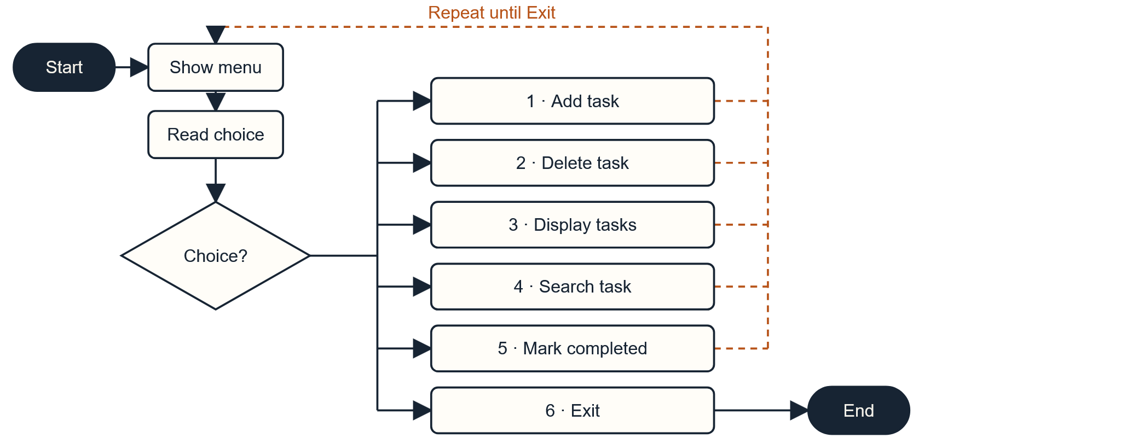
Flowchart

Slide 10
Challenges Faced
Task names with spaces
Deleting first, middle or last node
Read the whole line with scanf(" %[^\n]") instead of a single word.
Kept a previous pointer and updated head when the first node is removed.
Adding at the end
Memory leaks
Traversed to the last node before linking the new one.
Freed every deleted node with free().

Slide 11
Future Scope
Save tasks to a file
Edit an existing task
Due dates and priorities
Block duplicate task IDs
Sort tasks by date or priority
GUI or mobile version

Slide 12
Conclusion
What was achieved
What we learned
A working menu-driven task manager in C
Add, display, search, complete and delete
No fixed limit on the number of tasks
Creating, traversing and unlinking nodes
Using malloc() and free() correctly
Handling pointers and edge cases

